Slide 1
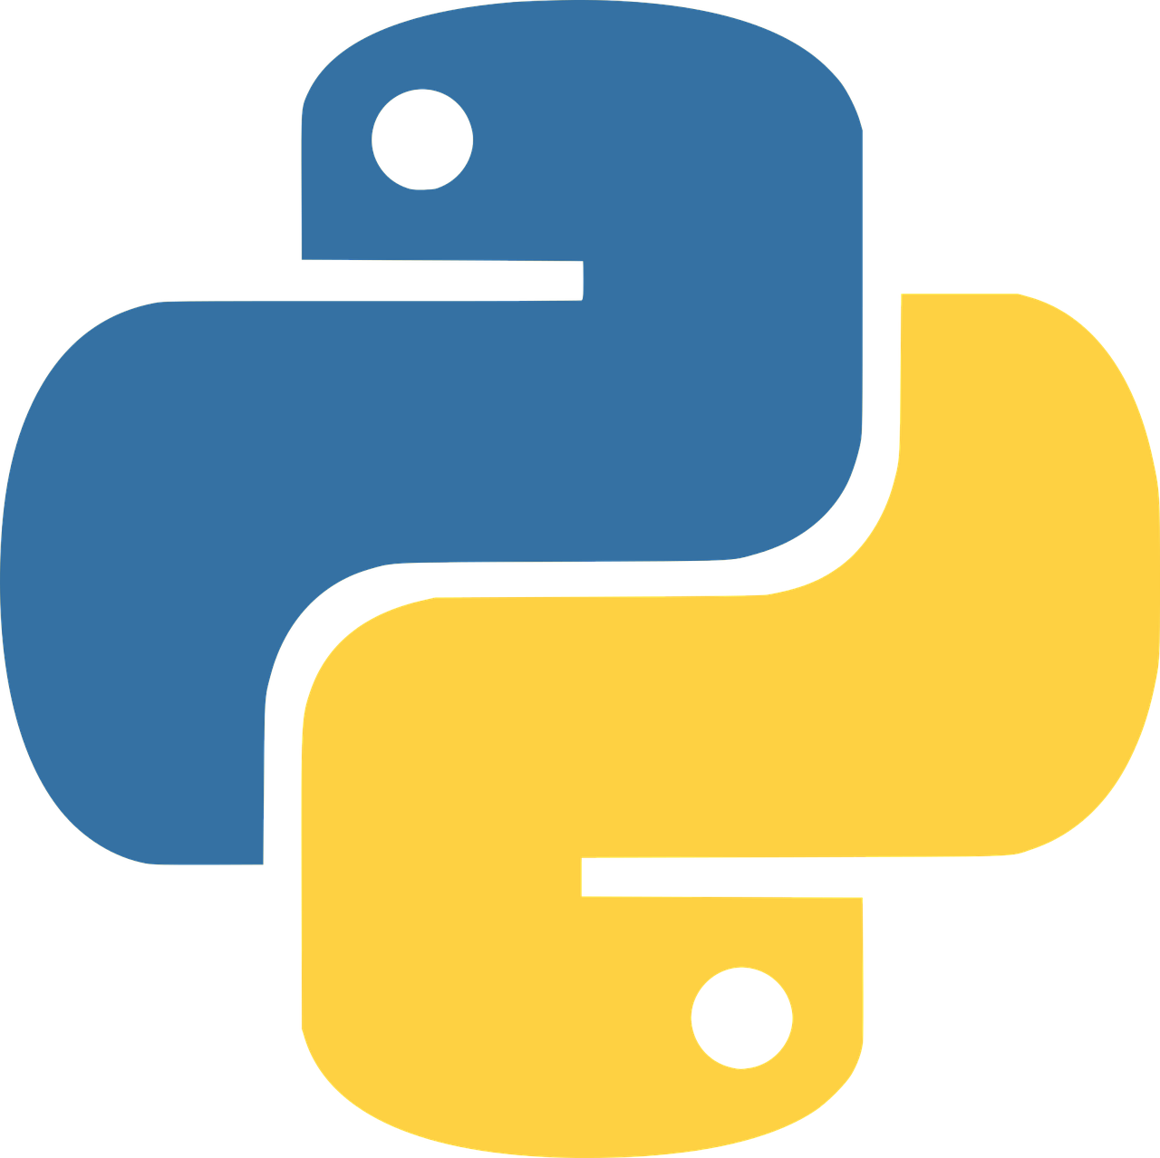
Introduction
to Python
Mahdi Shafiee Kamalabad

Slide 2

How is your programming skill? ☺
I do not know how to write a program at all.
I know it just a little bit (very basic).
I am an intermediate programmer (some experience).
I am a professional programmer.
Please go https://www.menti.com/ and answer,
Code: 2310 4691

Slide 3
https://www.mentimeter.com/s/2c3817841872ff05dd4d8d8c101e7094/60e73b8a9081/edit

Slide 4
The content of this workshop is as follows
1. Python Overview
Brief History
Usage of Python
4. Python Coding
Python Object
Python Data Structure Basics
Python Comparison Operators
Python Statements
Methods and Functions
A Tour in NumPy Library
A Tour in Pandas Library
A Tour in Matplotlib Library
2. Installing Python
Install Anaconda Distribution for Python
Briefly running Jupyter Notebook
Exploring “no install” online options
3. Running Python Code
Text Editors and Full IDEs
Notebook Environments
Jupyter Notebook
A Quick Tour in Jupyter Notebook

Slide 5
This workshop in particular is geared towards people new to programming.

Slide 6
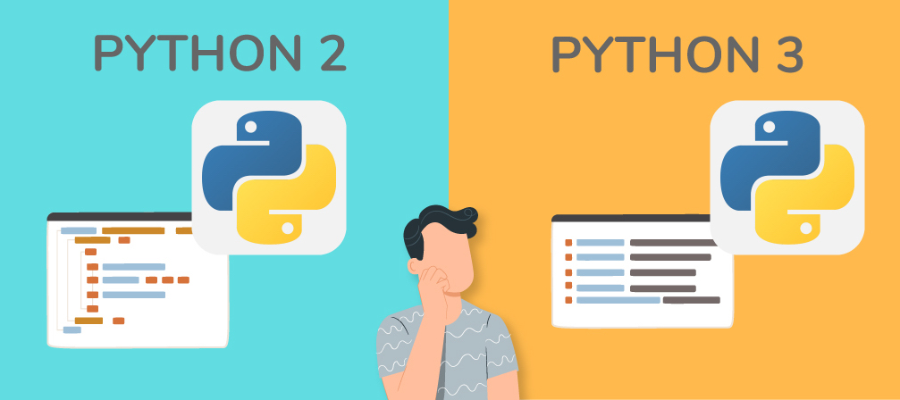
First let's see which one: Python 2 vs Python 3

Slide 7
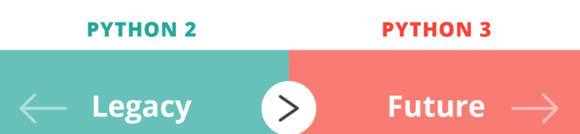
Now every major external python package has been updated to support Python 3!
This workshop now focuses on Python 3.
If need be, going back to Python 2 syntax is a very easy jump once you know Python 3.
Python 3 is indeed the future of Python.

Slide 8
Python Overview

Slide 9

Brief History of Python
Created in 1990 by Guido van Rossum
Python 3 released in 2008
Specifically designed as an easy-to-use language

Slide 10
Why Choose Python?
Designed for clear and logical code that is easy to read and learn.
It has a simple syntax.
Lots of existing libraries and frameworks written in Python allow users to apply Python to a wide variety of tasks.
Can be easily written and executed much faster than other programming languages.
Great documentation online:
docs.python.org/3

Slide 11

We first focus on “base” Python,
which consists of the core components of the language, and
writing scripts and small programs.

Slide 12

What can you do with Python?
Automate simple tasks
Searching for files and editing them
Scraping information from a website
Reading and editing excel files
Working with PDFs
Writing emails and text messages
Filling out forms

Slide 13

What can you do with Python?
Data Science and Machine Learning
Analyze large data files
Create visualizations
Perform machine learning tasks
Create and run predictive algorithms

Slide 14

What can you do with Python?
Create websites
Use web frameworks such as Django and Flask to handle the backend of a website and user data
Create interactive dashboards for users

Slide 15

Once you understand the base Python and begin working with a few libraries, you’ll quickly start to see Python's vast potential for your own projects!

Slide 16
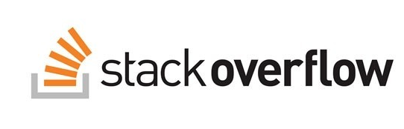

Strongly recommended to
quick Google or StackOverflow search!

Slide 17
Installing Python

Slide 18
There are many ways to run Python!
Later, we will explore the difference between running a Python .py script or running Python code in a Notebook environment.
Either way, we will still want to install Python!

Slide 19
Installation
Install Anaconda Distribution for Python.
Anaconda installs Python. It is an easy-to-use development environment and navigator launch tool.
Briefly run Jupyter Notebook.
Explore “no install” online options.

Slide 20

Quick Note:
Many online “no install” Python environments that can run in the browser (given that you have internet).
We will give you a brief tour of these online “no install” options at the end.

Slide 21

Install Anaconda
To install Python, we will use the free Individual Anaconda distribution.
This distribution includes Python as well as many other useful libraries, including the Jupyter Notebook environment.
Anaconda can also easily be installed on any major OS, Windows, MacOS, or Linux.

Slide 22
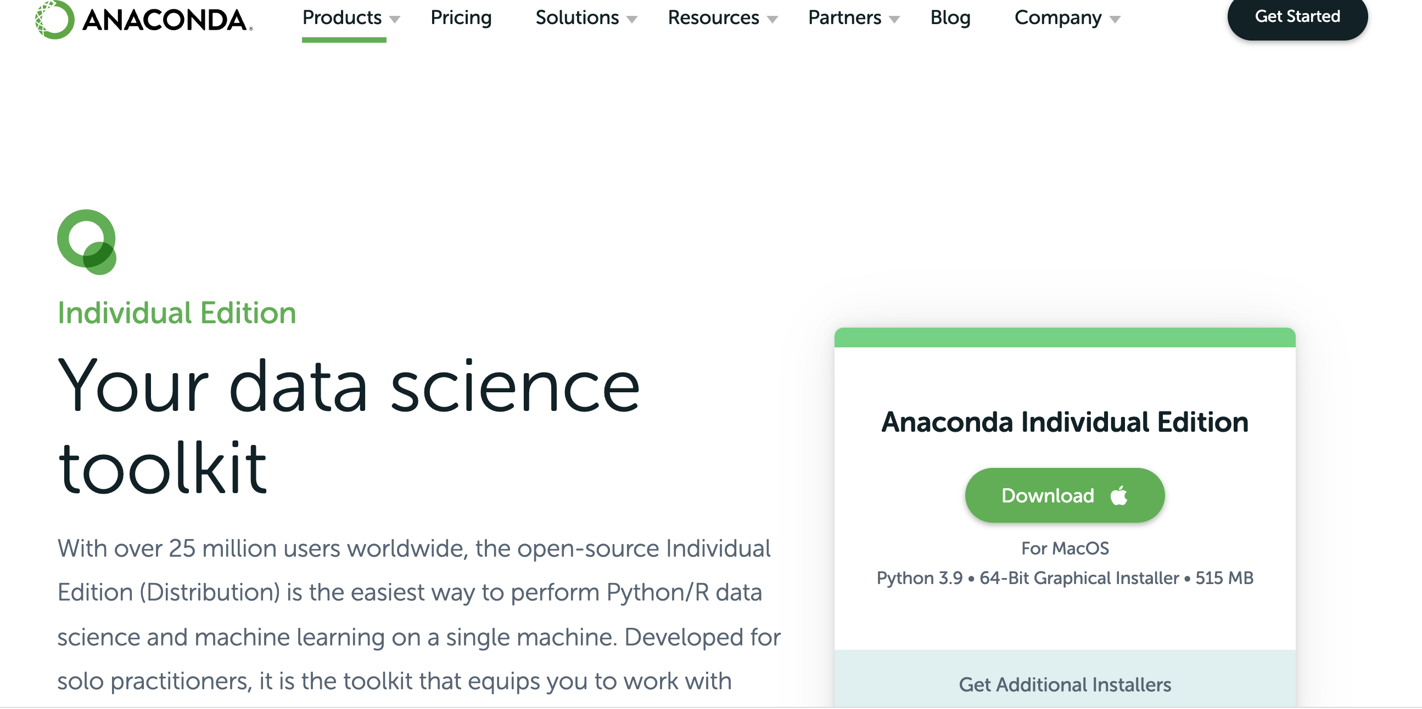
www.anaconda.com/downloads

Slide 23
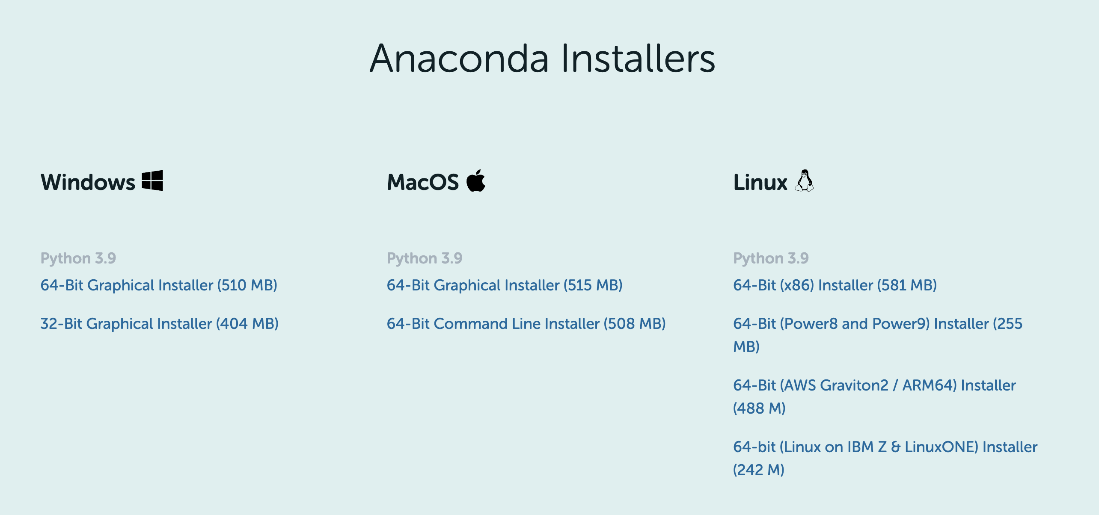
Select the installer as per your operating system.

Slide 24
In case, you have trouble installing
Tutorial video for installing anaconda on Windows
https://www.youtube.com/watch?v=aN6OVm0mTHo
Tutorial video for installing anaconda on MacOS
https://www.youtube.com/watch?v=2JeoNlCcLOM

Slide 25
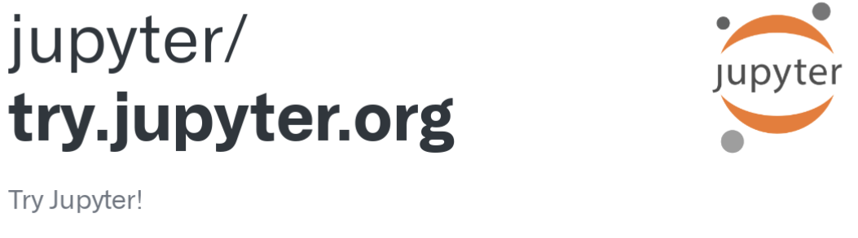
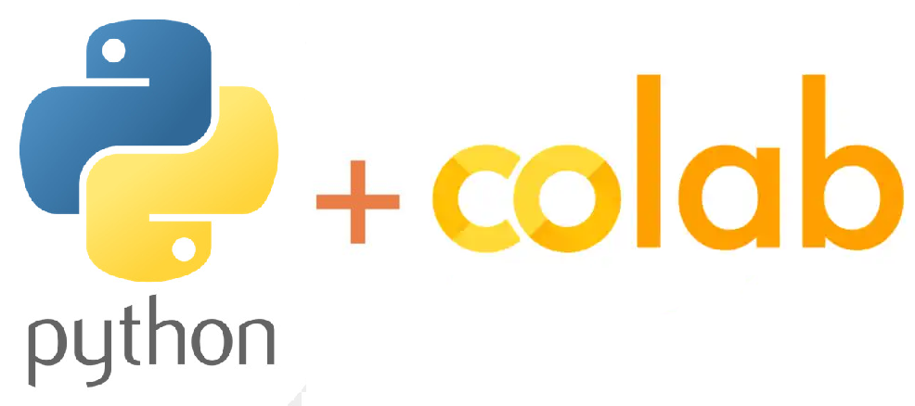

Free “No Install” Options:
https://jupyter.org/try
Google Colab Online Notebooks
Repl.it
Google Search:
“Python Interpreter Online”

Slide 26
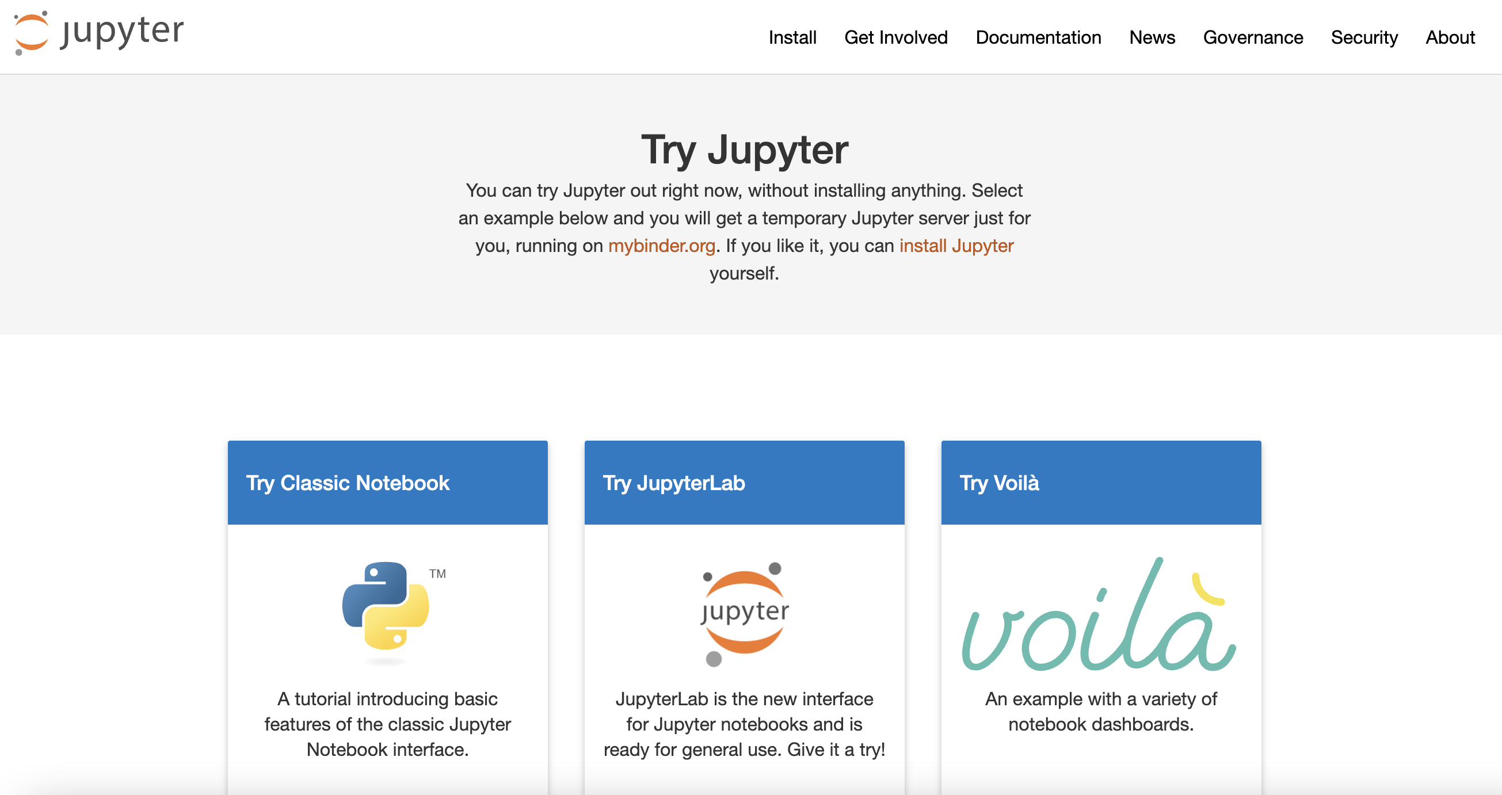
try.jupyter.org Click “Try JupyterLab”

Slide 27
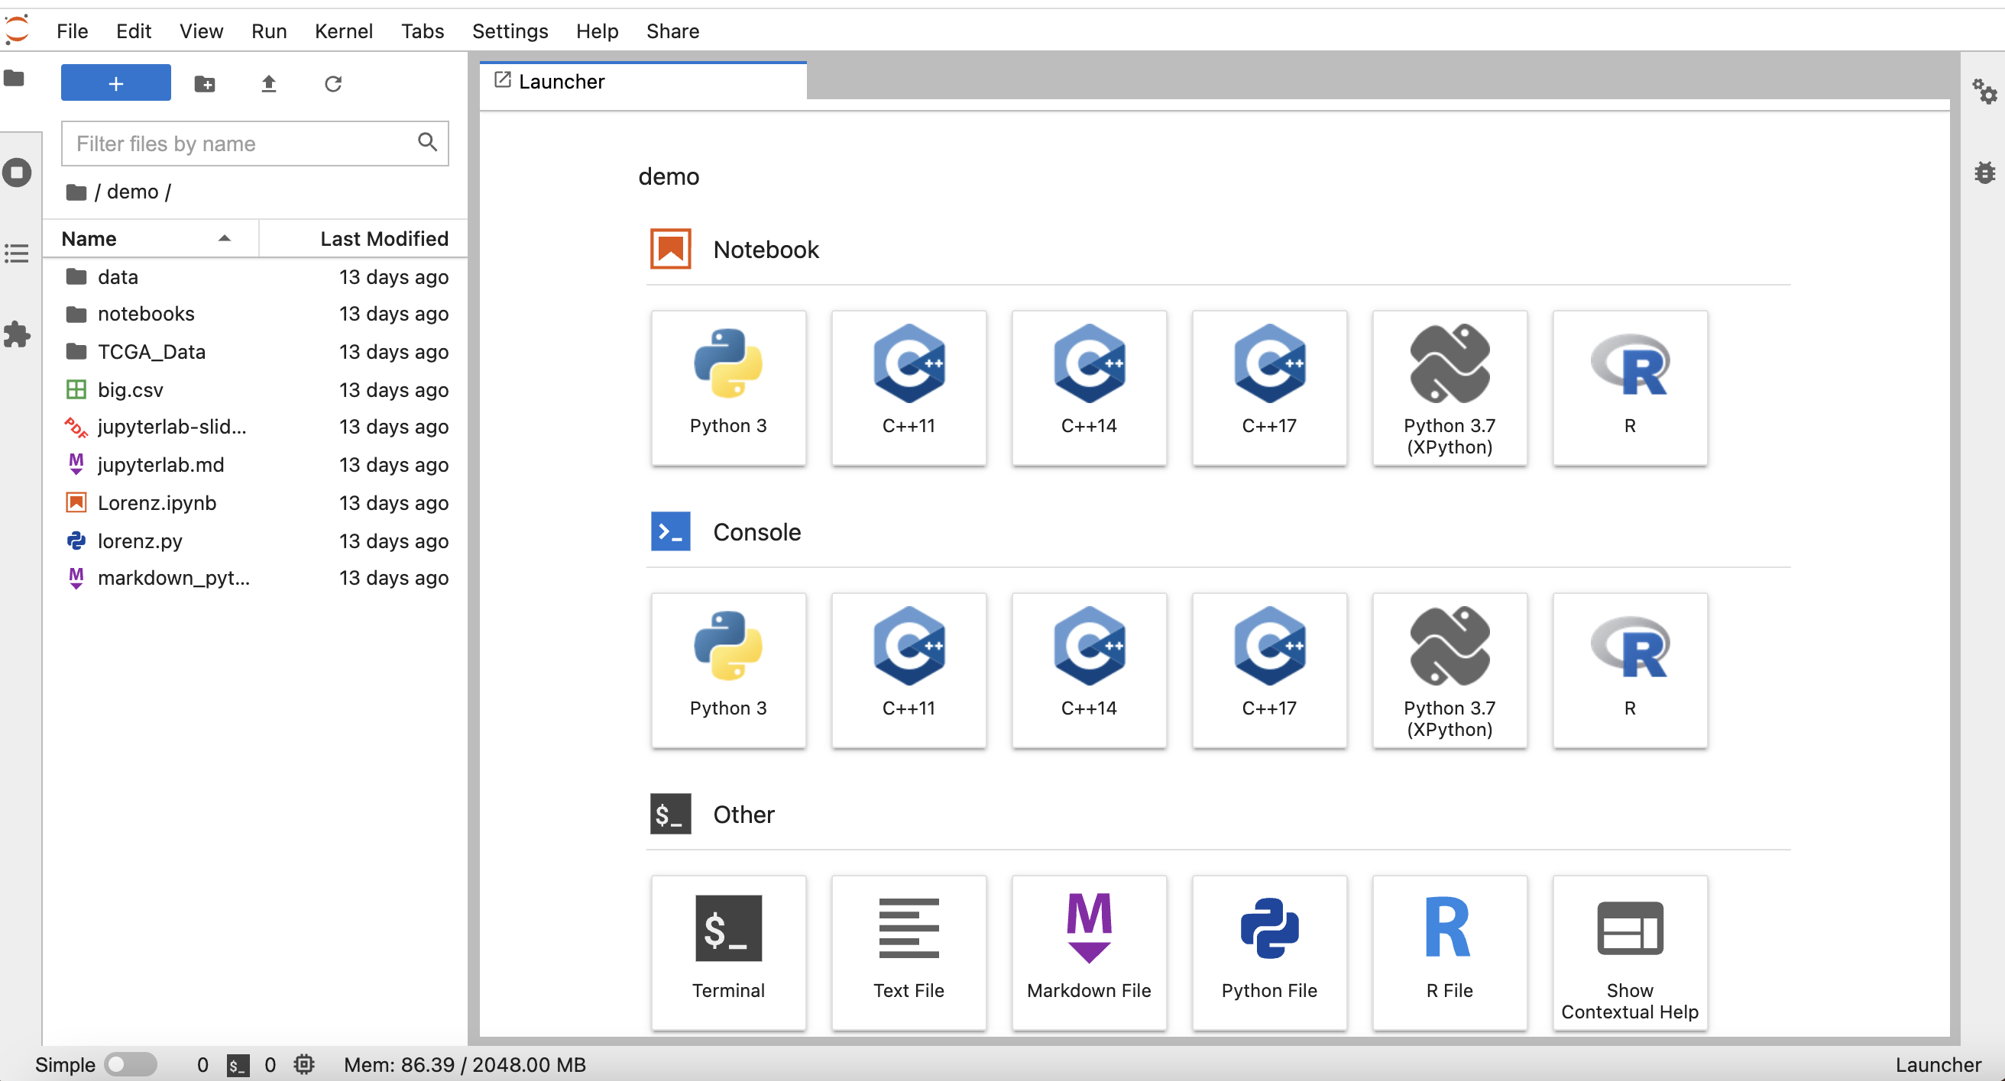
Once you’ve landed in the Launcher page, you can start working on your own file by clicking: “File → New → e.g. Notebook”

Slide 28
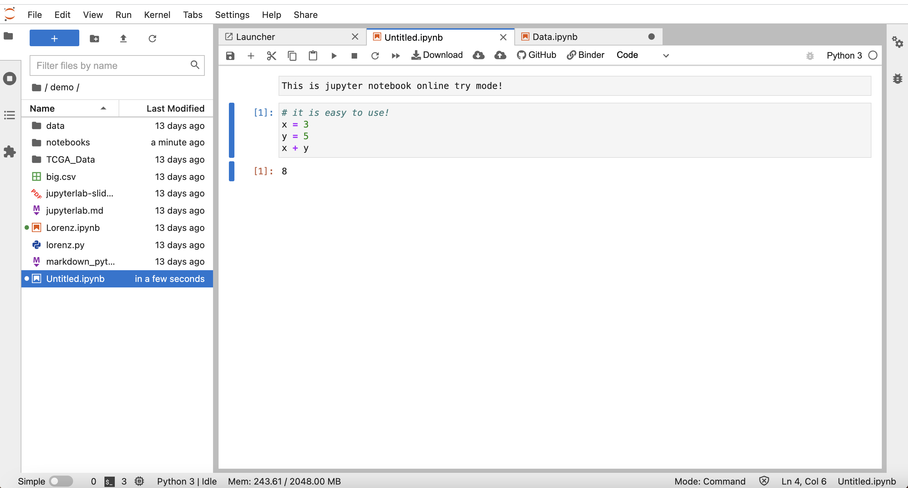

Slide 29
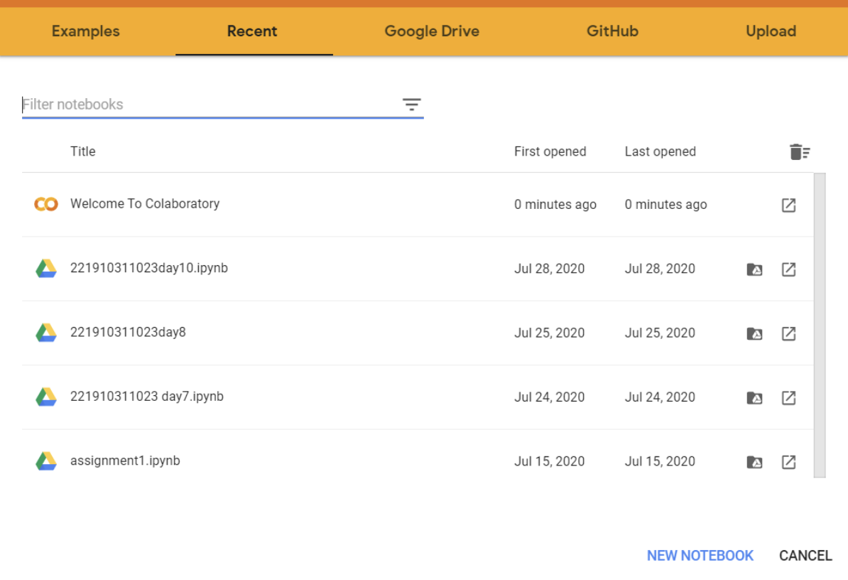
https://colab.research.google.com/
“Google Colab”
To start using Google Colab, you first have to log in to your Google account.
The home screen of Google Colab will look like this.

Slide 30
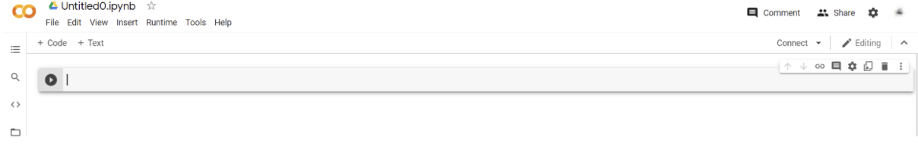
To open a new Python notebook, click ‘new notebook’ in the bottom right corner.
The opened notebook will look like this.

Slide 31
Quick Note
Free “No Install” Options:
Hard to upload your own code, data, or notebooks!
May not save your code in the free version!

Slide 32
Running Python Code

Slide 33
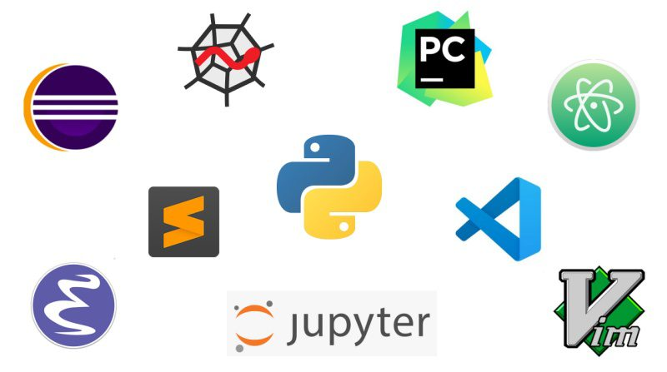
There are several ways to run Python code.
First, let’s discuss the various options for development environments.
There are 3 main types of environments:
Text Editors
Full IDEs
Notebook Environments

Slide 34
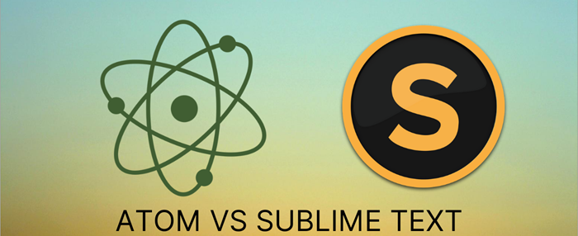
Text Editors
Most popular : Sublime Text and Atom

Slide 35
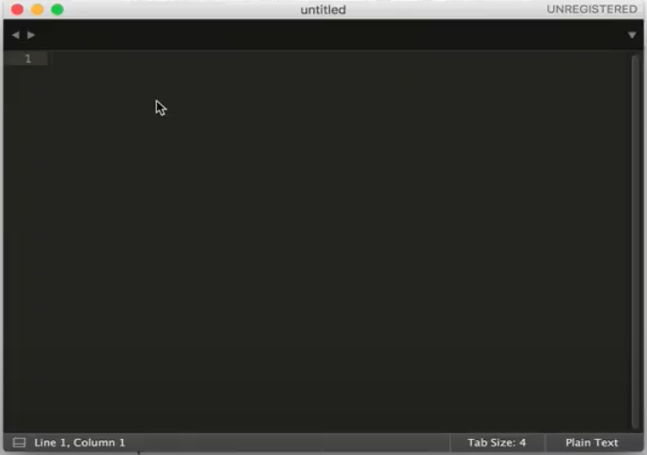
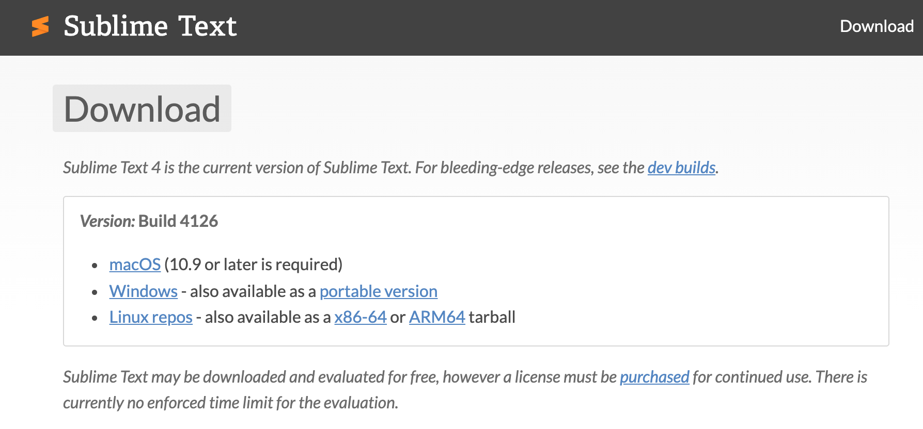
Sublime Text
You can download the .exe package from the official website: https://www.sublimetext.com/
Upon successful installation, your editor will appear, as shown below.

Slide 36
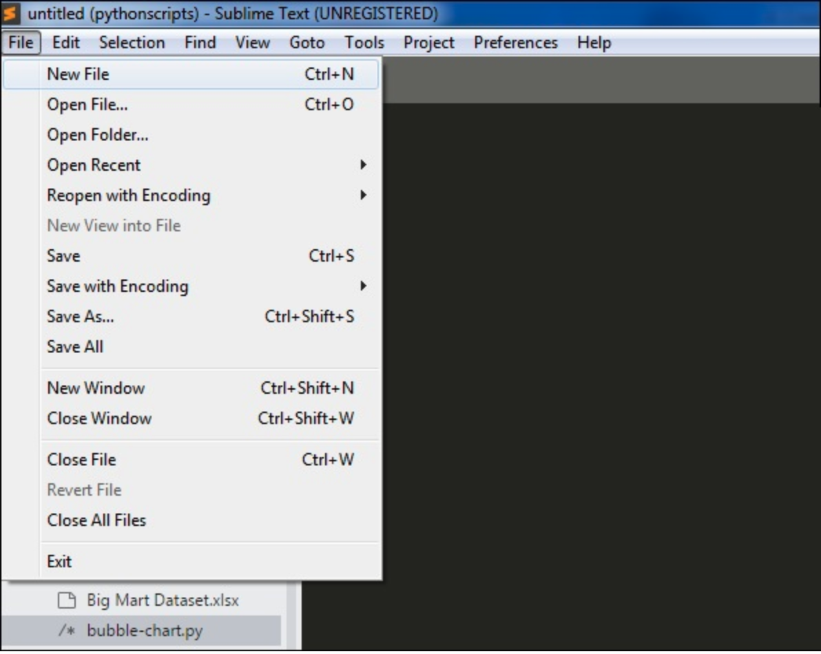
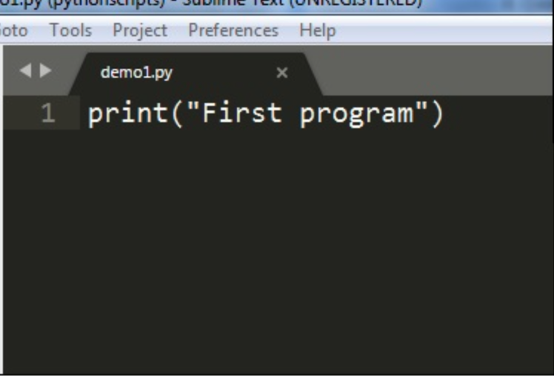
Creating the first document
Step 1: Use the option “New File” to create a file in Sublime Text editor.
Step 2:Once the new file is available, you can start writing the code.
Just as the other text editor, Sublime Text saves the file in your working directory.
More tutorials on Sublime Text is available at:
https://www.tutorialspoint.com/sublime_text/index.htm

Slide 37

Full IDEs
Development Environments explicitly designed for Python.
Larger programs.
Designed specifically for Python, with lots of extra functionality.
Most popular: PyCharm and Spyder
*Quick note:
PyCharm is available in three editions: “Professional”, “Community”, and “Edu”.
Only the “Community” and “Edu” editions are free, but they have relatively fewer features available.

Slide 38

Notebook Environments
Great for learning.
See input and output next to each other.
Support in-line markdown notes, visualizations, videos, and more.
Special file formats that are not .py
Most popular: Jupyter Notebook

Slide 39
Choose whichever development environment you prefer!
Here we work with Jupyter notebook.

Slide 40
Course Notebooks

Slide 41
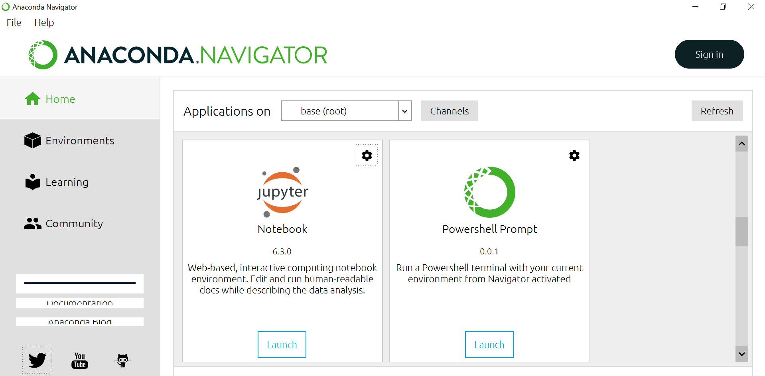
Initiate Anaconda and launch Jupyter Notebook.

Slide 42
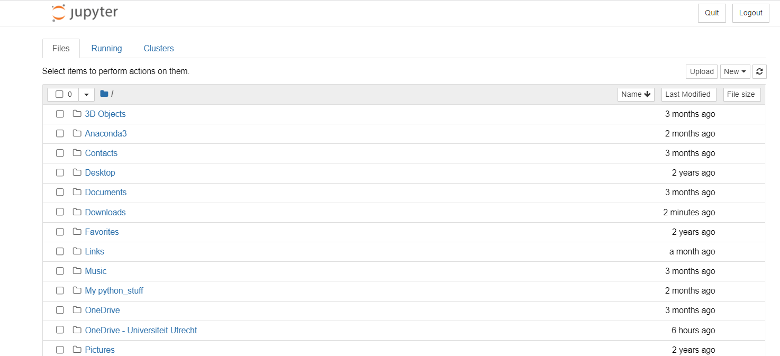
You will see the following Juypter Notebook page open in your browser.

Slide 43
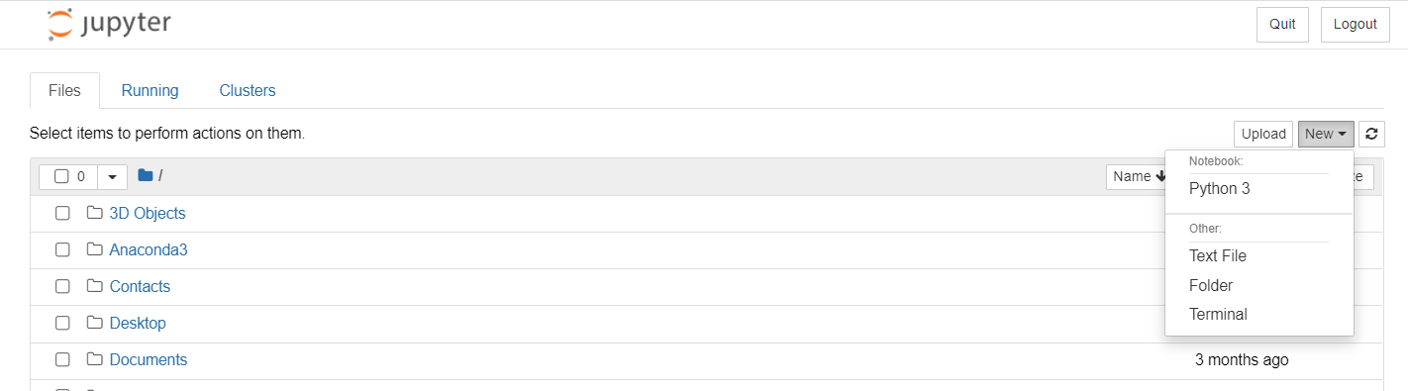
Click “New → Python3” to start with a new notebook file.

Slide 44
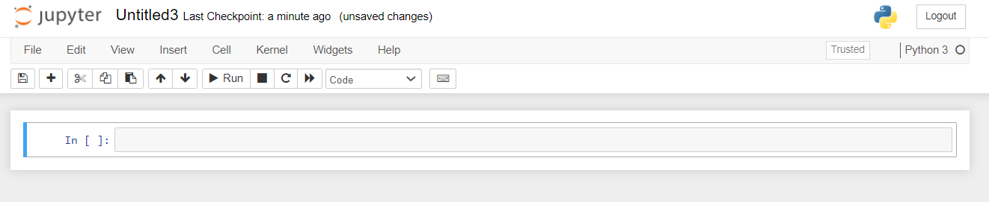
You will see an Untitled notebook page with an empty cell like the one below.

Slide 45
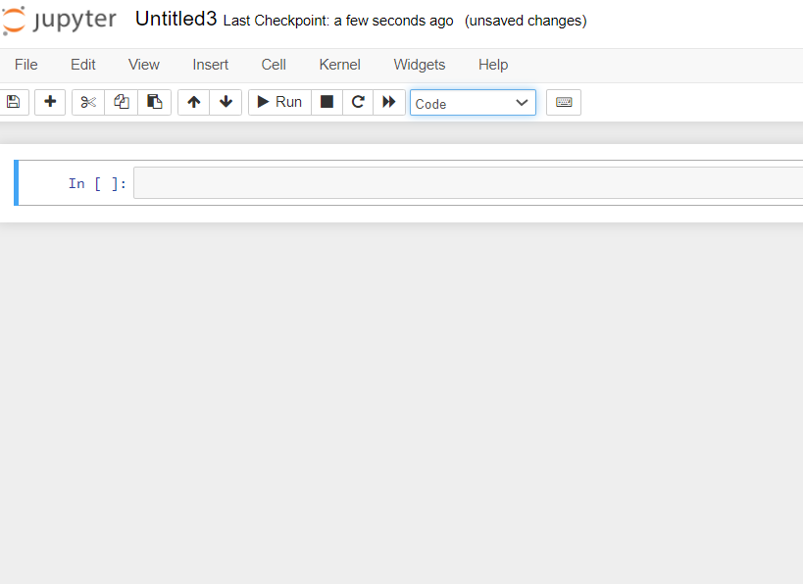
CELLS IN JUPYTER NOTEBOOK
Two types of cells: Markdown and Code cells
- Markdown cells : For text
- Code cells: For python code

Slide 46
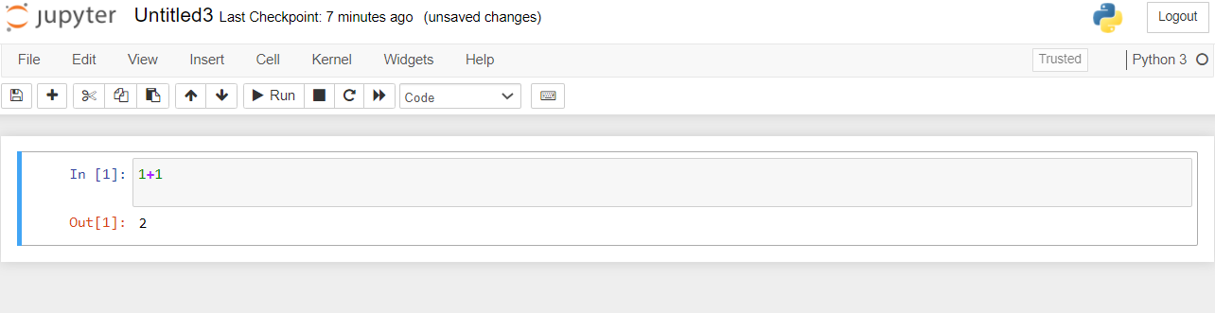
RUN PYTHON
Write some code in a code cell (the default one) and click the “run (play) button” (shortcut: “Ctrl+Enter”).

Slide 47
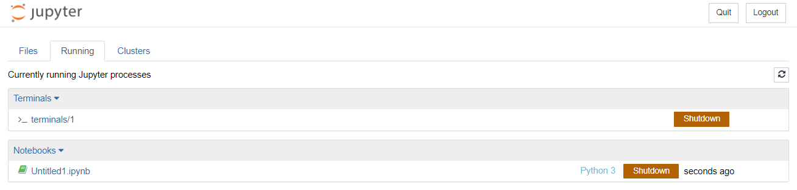
In the Jupyter Notebook dashboard, there is a tab named “Running” that shows all running notebooks (i.e. kernels) and allows shutting them down (by clicking on a “Shutdown” button).
“Running” TAB

Slide 48
WHY JUPYTER NOTEBOOK ?
Allow for interactive use.
Can combine text, code, and plots easily.
Jupyter notebook allows you to do fancy things. For instance :
Simply hit the “Tab” key while writing code. This will open a menu with suggestions. Hit “Enter” to choose the suggestion.
Help if you type "?" (example in next cell)
Magic cells like "%matplotlib inline" makes the plot inside the notebooks.
Shortcuts: “Ctrl+Enter”: Run cell. “Shift+Enter”: Run cell and go to the next one.
Check the link below for other useful tricks :
https://towardsdatascience.com/15-tips-and-tricks-to-use-jupyter-notebook-more-efficiently-ef05ede4e4b9

